Slide 1
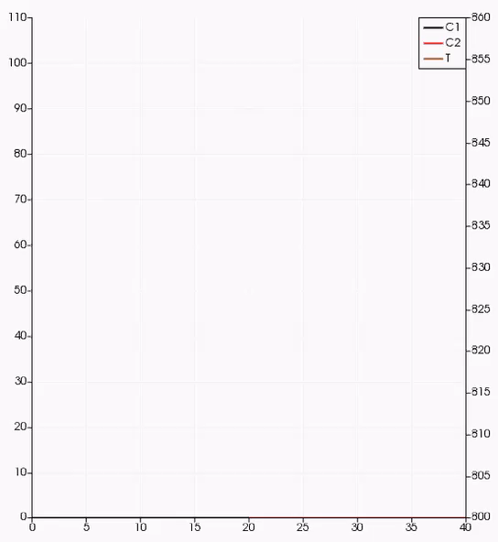
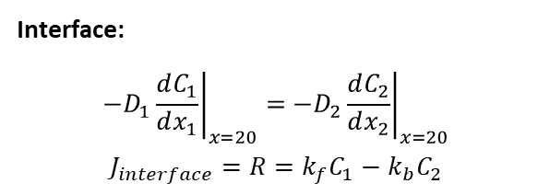



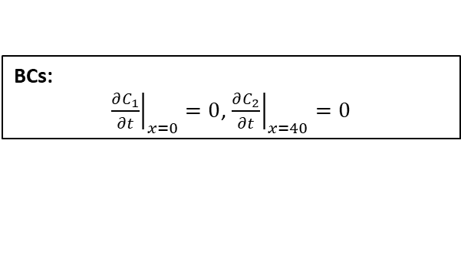
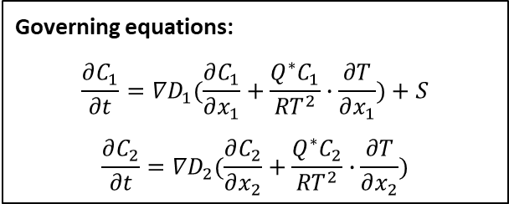
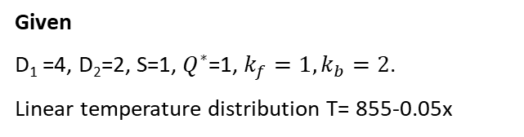
$$\left.c_{1}(x_{1},t\right)$$
Solid
$$\left.c_{2}(x_{2},t\right)$$
Liquid
Animation for concentration evolution
0
20
40
Governing equations:
$$\frac{∂C_{1}}{∂t}={∇D}_{1}(\frac{∂C_{1}}{∂x_{1}}+\frac{Q^{∗}C_{1}}{{RT}^{2}}∙\frac{∂T}{∂x_{1}})+S$$
$$\frac{∂C_{2}}{∂t}={∇D}_{2}(\frac{∂C_{2}}{∂x_{2}}+\frac{Q^{∗}C_{2}}{{RT}^{2}}∙\frac{∂T}{∂x_{2}})$$
BCs:
${\left.\frac{∂C_{1}}{∂t}\right|}_{x=0}=0$, ${\left.\frac{∂C_{2}}{∂t}\right|}_{x=40}=0$
ICs:
$C_{1}\left(x_{1},0\right)=0$, $C_{2}(x_{2},0)=0$
Interface:
$${\left.−D_{1}\frac{dC_{1}}{dx_{1}}\right|}_{x=20}={\left.−D_{2}\frac{dC_{2}}{dx_{2}}\right|}_{x=20}$$
$$J_{interface}=R=k_{f}C_{1}−k_{b}C_{2}$$
Given
D₁ =4, D₂=2, S=1, $Q^{∗}$=1, $k_{f}=1, k_{b}=2$.
Linear temperature distribution T= 855-0.05x

